Slide 1
Knightly Knockout

Slide 2
TABLE OF CONTENTS
Game Description
Completed prototype demo key points
01
02
What is the game
What points have been completed and how

Slide 3
Game Description
01

Slide 4
Knightly Knockout is a first person 1v1 swordfighting game. The first player to win 3 round wins.
The game will be networked multiplayer.

Slide 5
Completed prorotype features

Slide 6
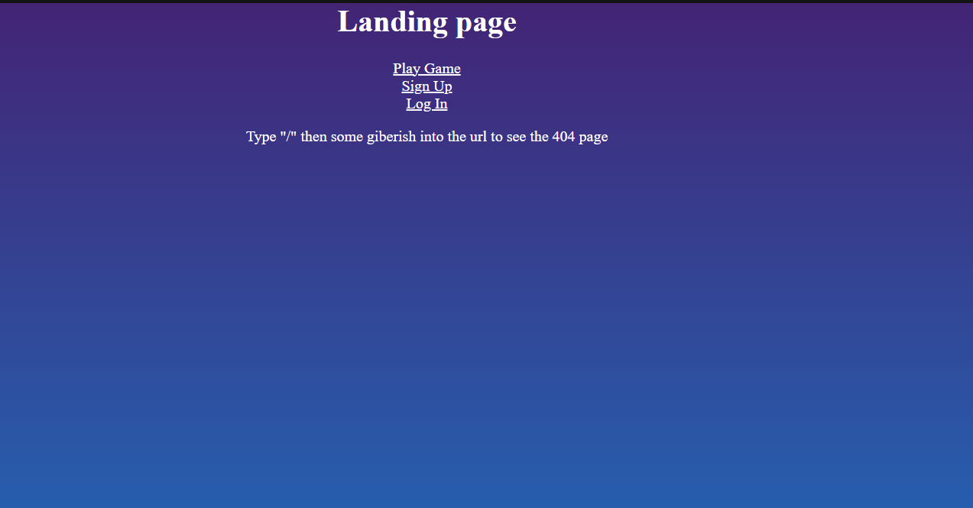
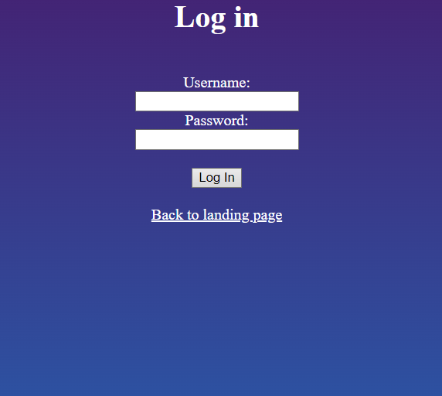
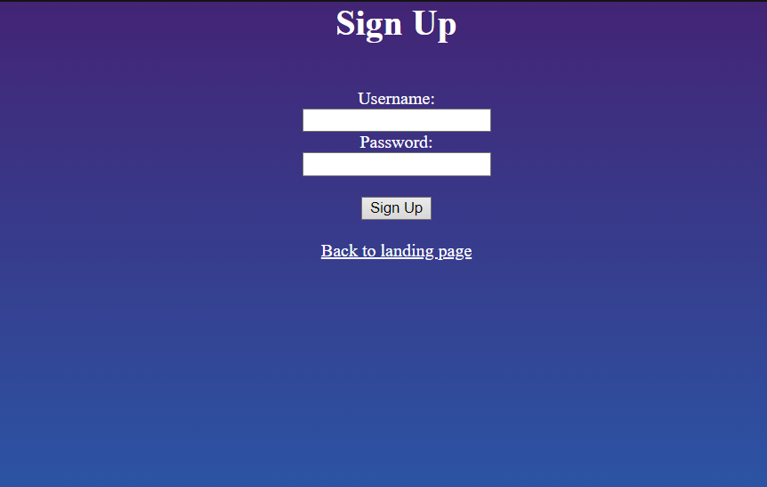
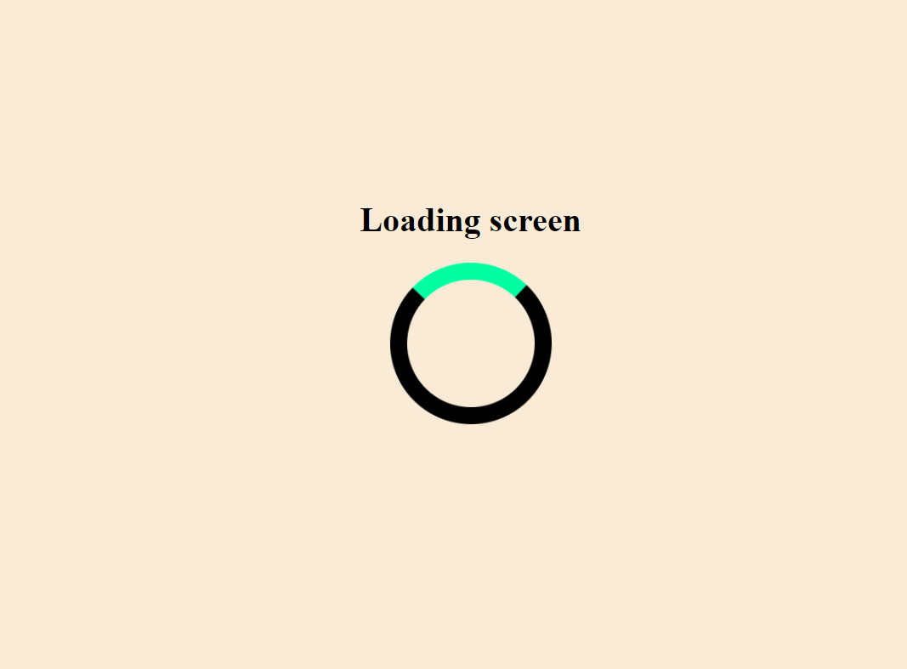
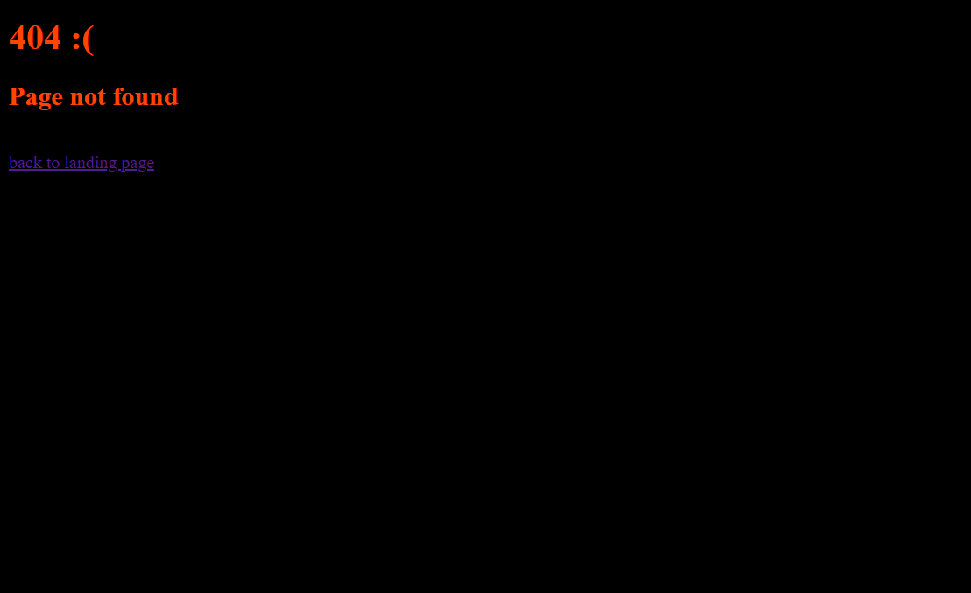
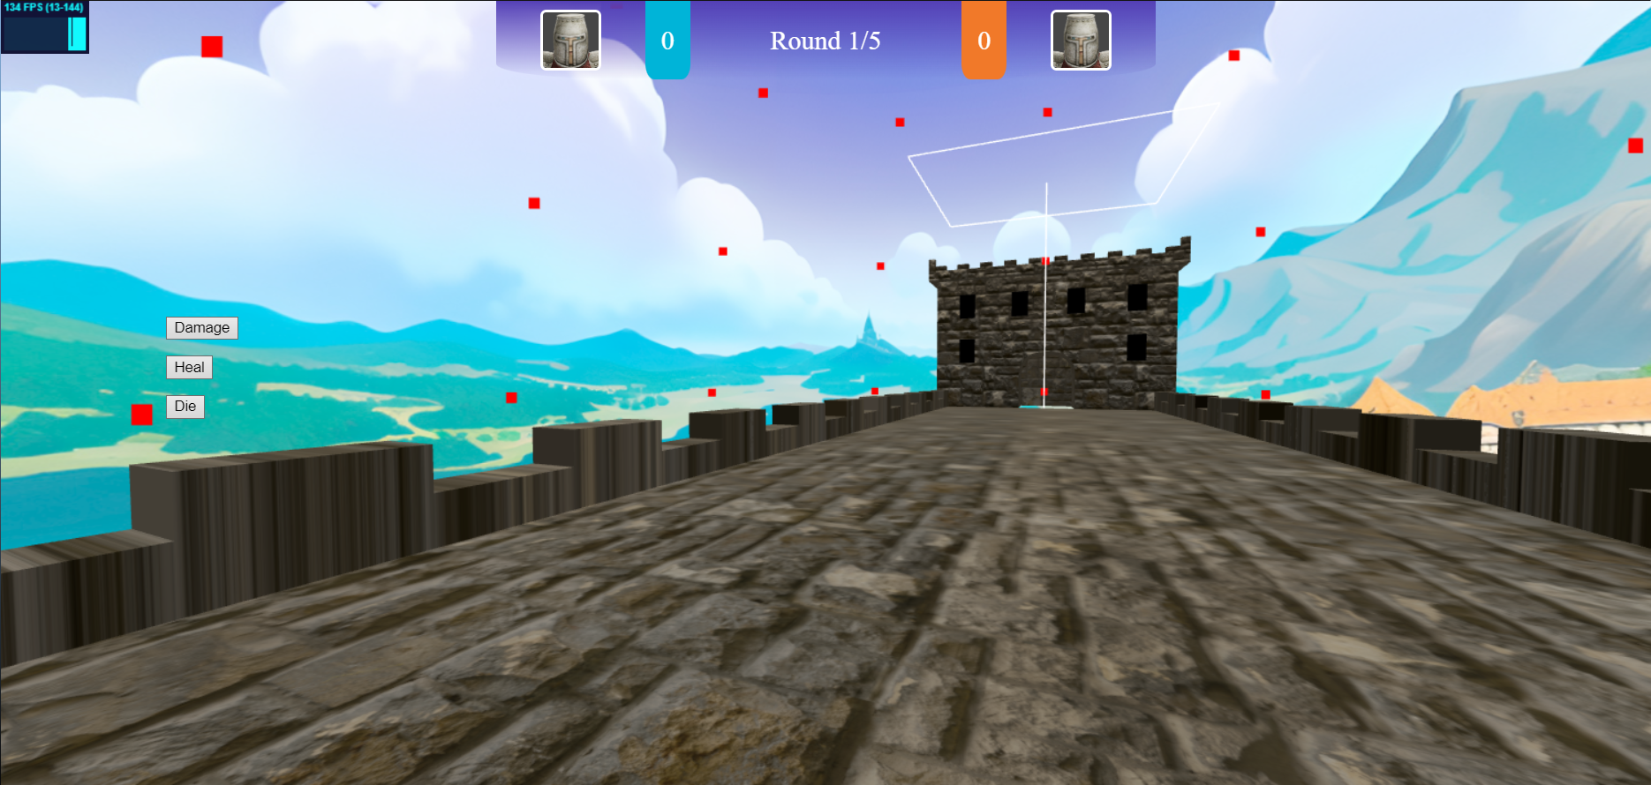
Completed features
Game websites design (client-side only): has Introduction page, Login page, New user register page, 404 page, game loading page and game pages.

Slide 7
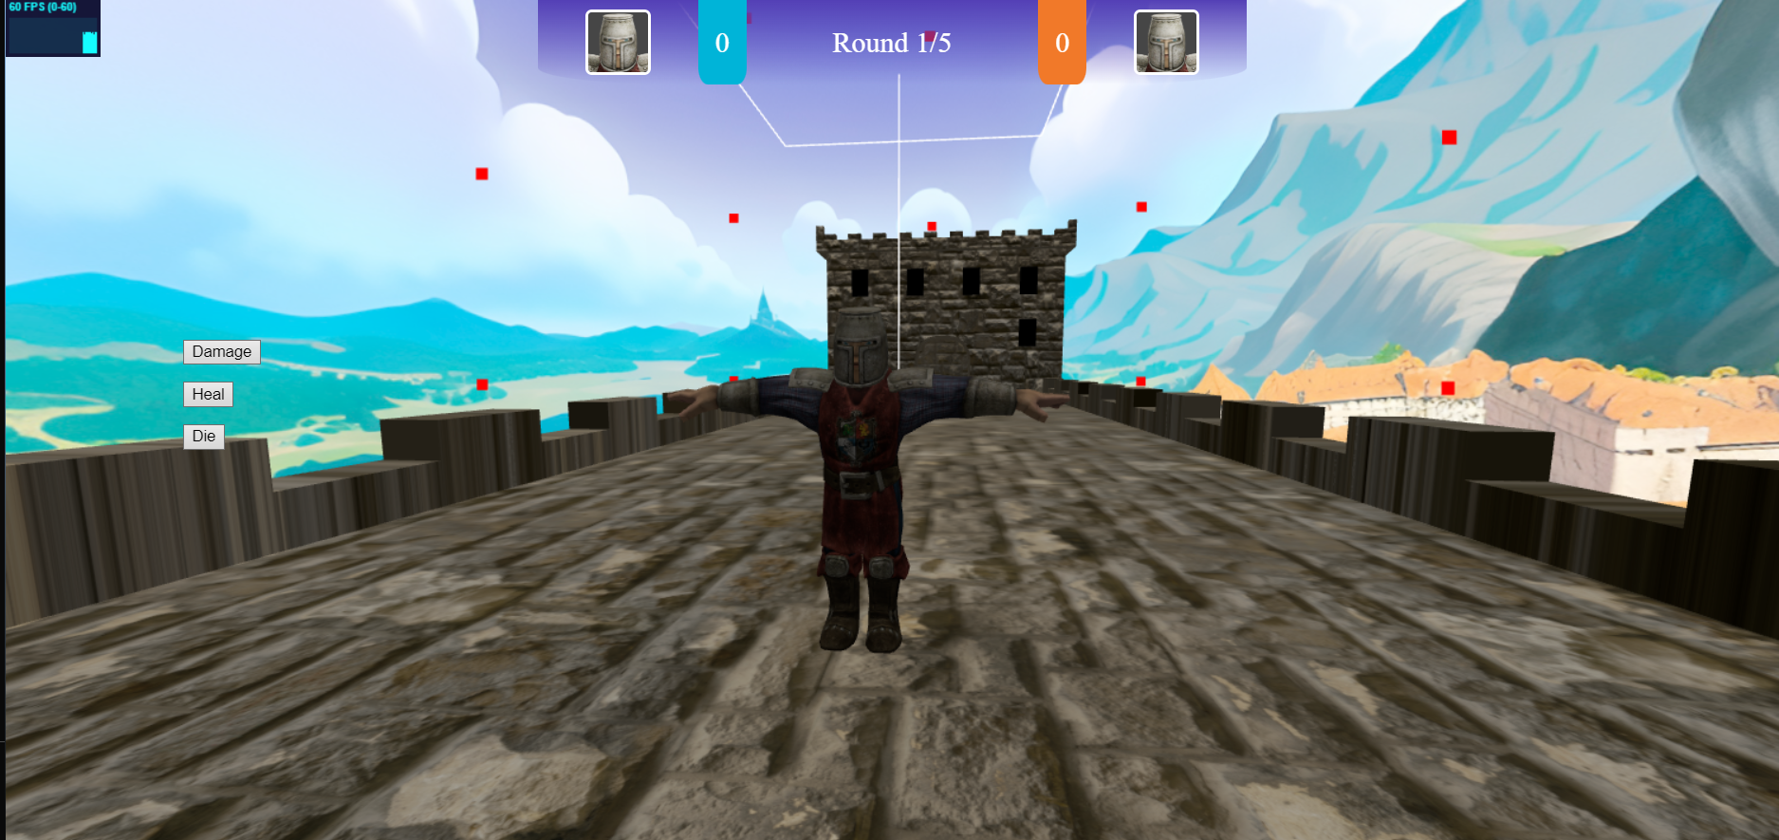
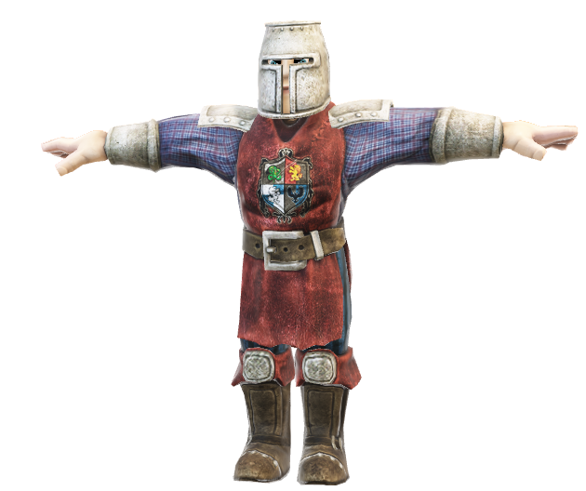
Completed features
Game assets: for example, character, landscape/environment and enemy design (if applicable).
Player/enemy character:
Castle Bridge environment:

Slide 8
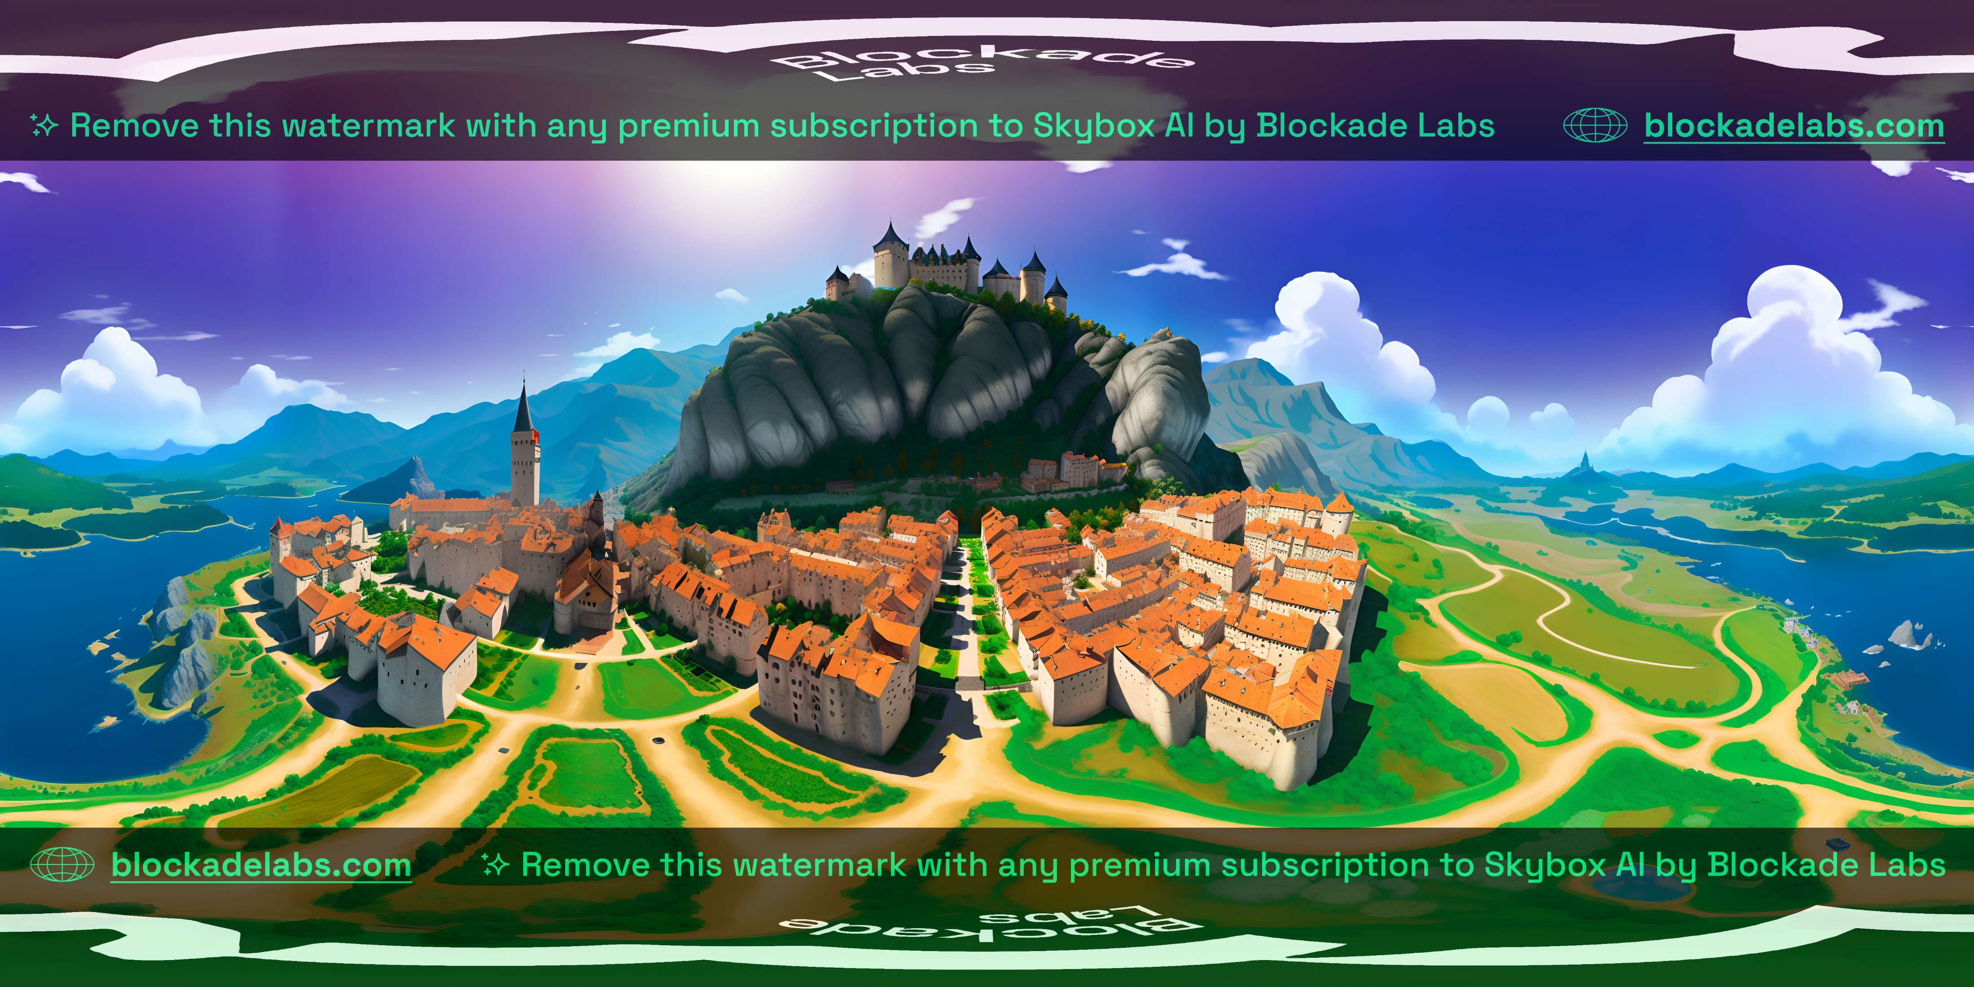
Completed features
Game material design: light, texture, material for the game assets
The player and the bridge both have textures which are packaged as part of the gltf file, additionally the cloud meshes generaged in the sky have lambert materials on them
As for lighting a directional light is used to light the scene.
An image texture is used to create the skysphere, giving the game a background

Slide 9
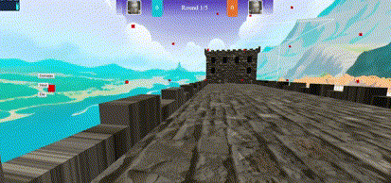
Completed features
Game animation: animation of game assets
Animation of game assets is shown whenever the player moves, their character is translated and moved through the scene

Slide 10
Completed features
Game interaction: user interaction with the game object
Interaction is done through the WASD keys, this makes the player move forwards, backwards left and right.
Additionally the damage, heal and die buttons can be used to alter the players health, which can cause them to die, updating the state of the game as the enemy player will get a point

Slide 11
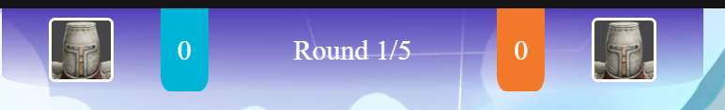
Completed features
Game UI: UI overlay on the web game for scores and life state etc.
Scores are displayed at the top of the screen, this is implemented entirely in css and html using css grid and flexbox so the scoring element is able to resize. The scores section is split into client, center and enemy.
When a player dies the opposing players score is increased and the round counter increases
Enemy profile picture
Client profile picture
Current round
Enemy score
Client score

Slide 12
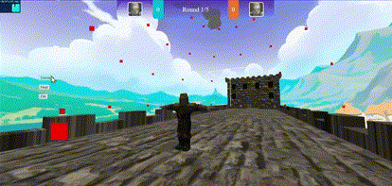
Completed features
Game UI: UI overlay on the web game for scores and life state etc.
Initially the life state of the player was going to be shown through a health bar. However it didn’t look right and was too intrusive on the ui.
Alternatively blood overlay is placed over the screen and its opacity is increased in synch with the players health. This is much more immersive, diagetic and also means the player doesn’t know their exact health which I like as it adds a guessing element and can help build tension.

Slide 13
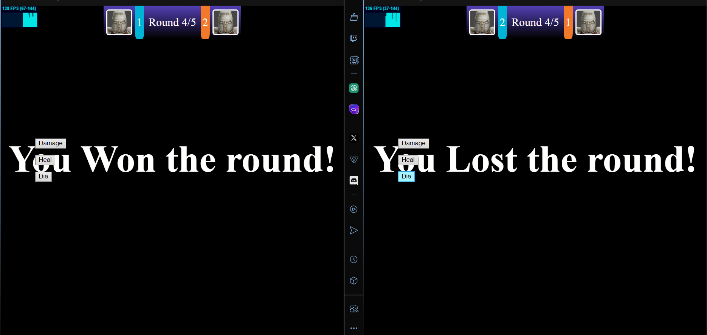
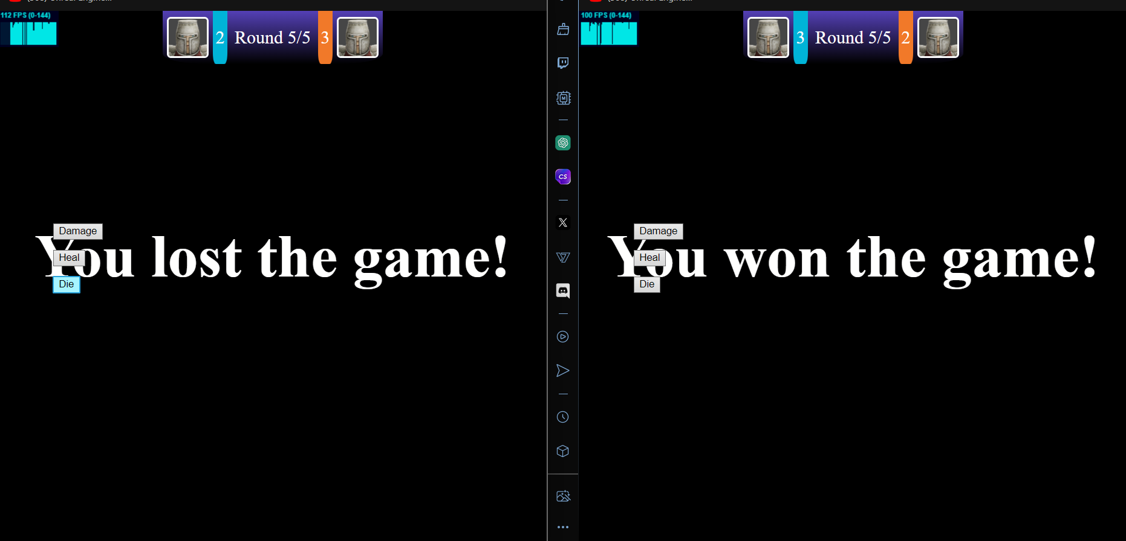
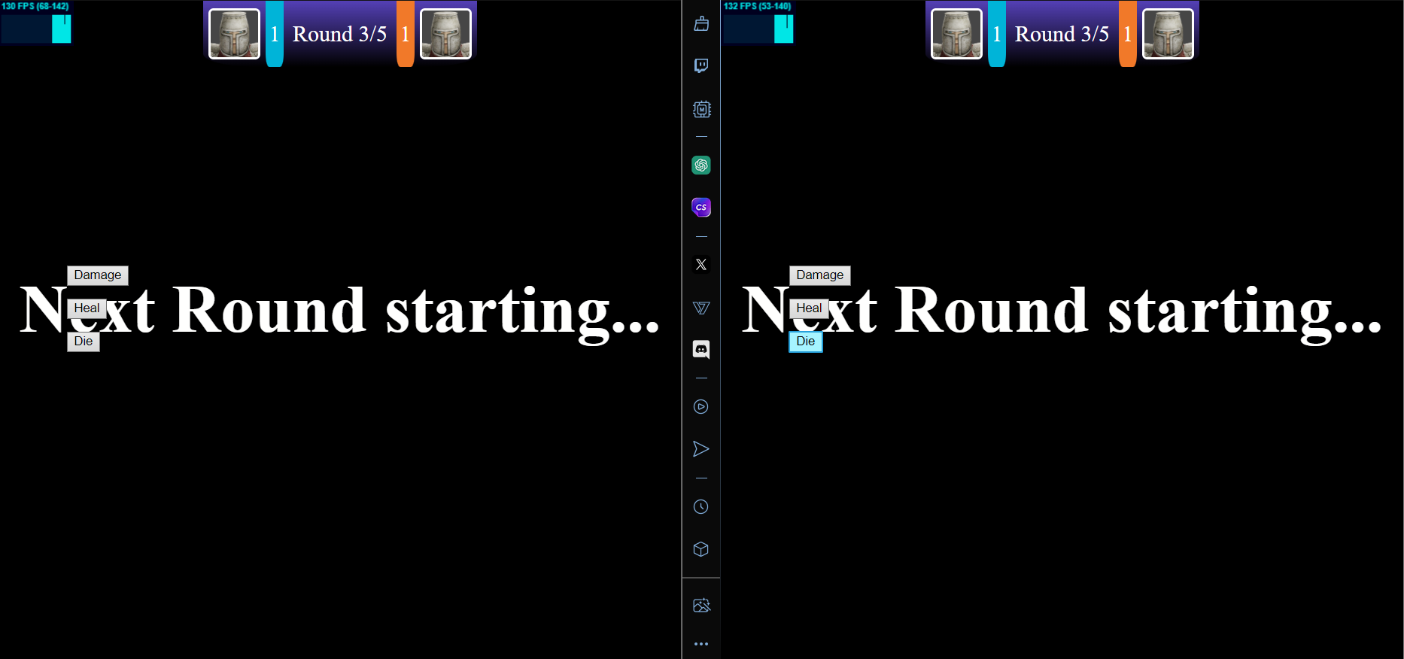
Completed features
Game mechanism: Fully functioning user interface displaying player statistics (i.e. lives or health), scores and rewards / penalties.
As well as player health and scores there are ui elements which display lives, rewards and penalties
Lives
When the player wins a round they are met with the you won a round screen, after winning 3 rounds the you won the game screen is shown
Rewards
When the player loses a round they see a you lost the round screen and see the other players score increase by 1, once the other player wins they will see a you lost screen
Penalties

Slide 14
Additional ui
Between rounds a next round starting screen is shown

Slide 15
Completed features
Responsive design: the web page and game are rendered according to the window size.

Slide 16
RESOURCES
Did you like the resources on this template? Get them for free at our other websites:
PHOTOS:
Low angle stone castle with trees
Low angle old stone castle
VECTORS:
Collection of different knight emblems
Knight emblem design set
Set of colorful knight emblems
Dark knight emblem templates
Set of elegant knight emblems

